Slide 1
Verifyer- Fake News Detector
By:
Kaashvi Varma
E23CSEU0130
Batch-5

Slide 2
Index
1. Problem Statement
2. Objective
3. Dataset Overview
4. Methodology
5. Evaluation Metrics
6.Results
7. Challenges faced
8. Future Scope
9. Conclusion
10. References

Slide 3
Problem Statement
In today’s digital age, the rapid dissemination of information has made it increasingly difficult to differentiate between authentic news and fabricated content. Fake news spreads quickly, often influencing public opinion, inciting social unrest, and leading to misinformation on critical issues such as politics, health, and finance.
Traditional methods of identifying fake news are insufficient to keep pace with the volume of online content, creating an urgent need for automated and scalable solutions. The challenge lies in leveraging machine learning techniques to accurately classify news articles as real or fake, while addressing issues such as data imbalance, diverse writing styles, and misleading content.
Goal: Develop an AI-powered system capable of analyzing textual content to identify fake news with high accuracy, providing a reliable tool to combat the spread of misinformation.

Slide 4
Objective
The objective of this project is to develop an AI-powered system that accurately classifies news articles as real or fake. This involves implementing effective text preprocessing, utilizing advanced feature extraction techniques like TF-IDF, and evaluating multiple machine learning models. The goal is to achieve high accuracy and reliability in detecting fake news, while addressing challenges such as data imbalance and noisy content. The system aims to provide a scalable solution for real-world applications to help combat the spread of misinformation.

Slide 5
Dataset overview
This is a dataset of 6000+ news articles out of which 50% are real and 50% are fake. It has been sourced from Kaggle.
Dataset contains four columns: Serial number (starting from 0); Title (about the text news heading); Text (about the news content); and Label (REAL or FAKE).
Preprocessing:
1. Getting rid of missing values 2. Getting rid of special characters, characters outside ASCII range and numbers. 3. Converting to lower case and splitting into words

Slide 6
Methodology- Processing
Lemmatization: is a text normalization technique used in natural language processing (NLP) to reduce words to their base or root form, called a "lemma“. For example:
The lemma of "running" is "run.“, the lemma of "better" is "good."
Removing stopwords: Stopwords are words that do not have muc significance. Example: “and”, ”the”, ”or” etc.
Sentiment Analysis: TextBlob provides sentiment scores with polarity (negative to positive, -1 to 1) and subjectivity (objective to subjective, 0 to 1)
Splitting the data: the dataset was split into training and testing subsets to facilitate model training and evaluation. Training- 80%, Testing- 20%

Slide 7
Methodology- Feature Engineering
Feature extraction is critical for transforming raw text into a format suitable for machine learning algorithms. For this project, the TF-IDF (Term Frequency-Inverse Document Frequency) vectorizer was used:
Term Frequency (TF): Measures how often a term appears in a document.
Inverse Document Frequency (IDF): Assigns scores to terms depending on the frequency of their appearance across the entire corpus. Higher weight is given to terms that are less frequent, highlighting distinctive words.
It is important to get rid of stopwords when using TF-IDF vectorizer.
This approach ensured the creation of meaningful numerical representations that capture the essence of each article.

Slide 8
Methodology- Model Deployment (1)
Model Deployment
The following models were trained on the processed dataset:
Bernoulli Naïve Bayes
Logistic Regression
Decision tree Classifier
Random forest
Voting classifier (Ensemble Model)

Slide 9
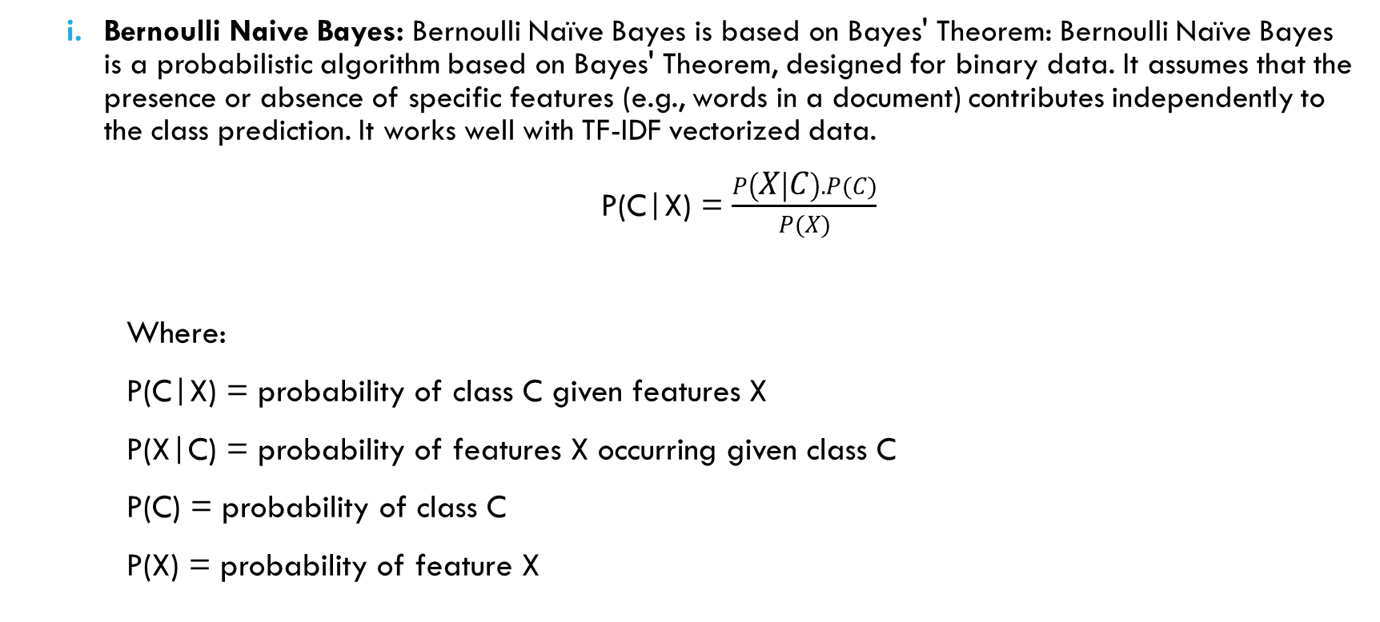
Methodology- Model Deployment (2)
Bernoulli Naive Bayes: Bernoulli Naïve Bayes is based on Bayes' Theorem: Bernoulli Naïve Bayes is a probabilistic algorithm based on Bayes' Theorem, designed for binary data. It assumes that the presence or absence of specific features (e.g., words in a document) contributes independently to the class prediction. It works well with TF-IDF vectorized data.
P(C|X) = $\frac{P\left(X | C\right).P(C)}{P(X)}$
Where:
P(C|X) = probability of class C given features X
P(X|C) = probability of features X occurring given class C
P(C) = probability of class C
P(X) = probability of feature X

Slide 10
Methodology- Model Deployment(3)
ii. Logistic Regression: Logistic Regression is a linear model for binary classification that estimates the probability of a sample belonging to a class using the sigmoid function.
It calculates the linear output by applying linear combinations to the input features.
The sigmoid function is then applied to this linear output.
This transforms the linear model output into a probability:
P(y=1∣X) = σ(z)
P(y=0∣X) = 1−σ(z)
Based on the probability from the sigmoid function, a threshold is applied (commonly 0.5) to assign a class:
If P(y=1∣X) ≥ 0.5, predict class 1.
If P(y=1∣X) < 0.5, predict class 0.

Slide 11
Methodology- Model Deployment(4)
iii. Decision Tree Classifier: A Decision Tree is a supervised machine learning algorithm used for classification and regression tasks. It works by splitting the data into subsets based on feature values, forming a tree-like structure where each internal node represents a decision on a feature, and each leaf node represents the final output (class or value).
Splitting:
The algorithm evaluates all possible splits for a feature to find the one that best separates the data into homogeneous groups.
Common criteria for splitting include Gini Impurity, Entropy, Variance Reduction
The tree continues splitting recursively, creating child nodes until a stopping condition is met.
Prediction:
Traverse the Tree: Start at the root node and evaluate the decision rules at each internal node based on the input features.
Follow the Branches: Move down the tree based on the decision conditions until a leaf node is reached.
Output: The class label or value associated with the leaf node is the final prediction.

Slide 12
Methodology- Model Deployment(5)
iv. Random Forest: Random Forest is a supervised machine learning algorithm that combines multiple decision trees to produce a more robust and accurate prediction. It uses a process called ensemble learning, where the output of several models is aggregated to improve performance and reduce overfitting. Each tree independently makes a prediction, and the final output is based on the majority vote (for classification) Random Forest uses bagging, where each tree is trained on a random subset of the training data sampled with replacement. This creates diversity among the trees, reducing overfitting. At each split in a tree, only a random subset of features is considered, adding further randomness and diversity. This ensures trees are not overly reliant on any particular feature.
v. Voting Classifier: It is a type of ensemble model in machine learning. It combines the predictions from multiple models (called "base estimators") to improve overall accuracy and robustness. It is not a standalone algorithm but a strategy for combining the outputs of other models. The strategy we have used to combine models is soft voting (The final prediction is the class with the highest average probability.)

Slide 13
Evaluation metrics (1)
We have evaluated the performance of the models using the following metrics:
Accuracy: Percentage of correctly classified instances.
Precision: The proportion of true positive predictions (e.g., fake news classified as fake).
Recall: The ability to correctly identify fake news.
F1-Score: The harmonic mean of precision and recall, providing a balance between the two.
Confusion Matrix

Slide 14
Evaluation Metrics (2)
Here are the results obtained from the evaluation:
Model | Accuracy | Precision |  | Recall |  | F1 Score
Bernoulli NB | 0.71 | Real | 0.73 | Real | 0.69 | Real | 0.71
 |  | Fake | 0.70 | Fake | 0.75 | Fake | 0.72
Logistic Regression | 0.83 | Real | 0.83 | Real | 0.86 | Real | 0.84
 |  | Fake | 0.85 | Fake | 0.82 | Fake | 0.84
Decision Tree | 0.77 | Real | 0.78 | Real | 0.78 | Real | 0.78
 |  | Fake | 0.77 | Fake | 0.78 | Fake | 0.78
Random Forest | 0.86 | Real | 0.87 | Real | 0.87 | Real | 0.87
 |  | Fake | 0.87 | Fake | 0.87 | Fake | 0.87
Ensemble Model | 0.85 | Real | 0.86 | Real | 0.85 | Real | 0.85
 |  | Fake | 0.85 | Fake | 0.86 | Fake | 0.85
Confusion Matrix of the models:
1. Bernoulli NB: [[468 160] [197 442]] 2. Logistic Regression: [[516, 112] [91,548]] 3. Decision Tree: [[485,143] [139,500]] 4. Random Forest: [[545,83] [85,554]] 5. Ensemble Model: [[540,88] [99,540]]

Slide 15
Results
Among the evaluated models, the Random Forest Classifier demonstrated the highest accuracy and balanced performance across all evaluation metrics, making it the most suitable choice for deployment in real-world scenarios.
Logistic Regression and Bernoulli Naive Bayes also performed well, offering simpler and faster alternatives with slightly lower accuracy.
The Decision Tree Classifier, while interpretable, showed the lowest accuracy, likely due to its tendency to overfit

Slide 16
Challenges Faced
While the system performs well on the dataset, its real-world applicability depends on the quality and diversity of training data. Future improvements can focus on incorporating larger and more diverse datasets.
Models may require periodic retraining to adapt to the evolving nature of fake news patterns and language.

Slide 17
Future Scope
To further enhance the system's performance and utility, future work could focus on: Incorporating Advanced Models: Exploring deep learning models like Recurrent Neural Networks (RNNs), LSTMs, or transformer-based models (e.g., BERT) for improved text understanding.
Expanding Dataset: Using a larger and more diverse dataset, including news from different languages and regions, to improve generalizability.
Real-Time Deployment: Optimizing the model for real-time fake news detection in production environments, including API integration and scalability.
Explainability: Adding mechanisms to explain the model's predictions, which can increase user trust and understanding of the system.

Slide 18
Conclusion
In this project, we developed a machine learning-based system to detect fake news, leveraging text preprocessing, feature extraction, and a variety of machine learning algorithms. By applying techniques like TF-IDF for feature representation and evaluating models such as Logistic Regression and Naive Bayes, we were able to build an effective model for classifying news articles as real or fake.
Through this process, we addressed challenges such as data imbalance and noisy content, optimizing our models to achieve reliable performance. This solution provides a scalable approach to combating the spread of misinformation, with potential for future improvements, including the integration of deep learning techniques and multilingual support.
Overall, this project demonstrates the potential of AI and machine learning in the fight against fake news, offering a practical tool that can be expanded and deployed for real-world applications.

Slide 19
References
1. Dataset from Kaggle
2. ChatGPT was utilized in the development of this project to assist with drafting, refining, and structuring the report, as well as providing insights and clarifications on key concepts
3. Libraries: Scikit-Learn, numpy, pandas, NLTK, Matplotlib, seaborn, plotly
4. Literary help from Google Scholar

Slide 20
Thank you!

